Slide 1
Eye cataract prediction:
binary classification through CNN
Francesco Cornetti

Slide 2
Cataract overview
Worldwide spread effects
1
Cataract, defined by the World Health Organization (WHO) as a visual acuity (VA) of less than 3/60 in the better eye
2
Leading cause of blindness in the world: it affects approximately #18 million people
Key figures and related issues
3
The most affected people (c. 90%) are in low/middle-income countries
4
Treatment only with surgery

Slide 3
Table of contents
Three main working areas
Page
1
Data pre processing
2
2
CNN algorithm & metrics
8
3
Visualization
12

Slide 4
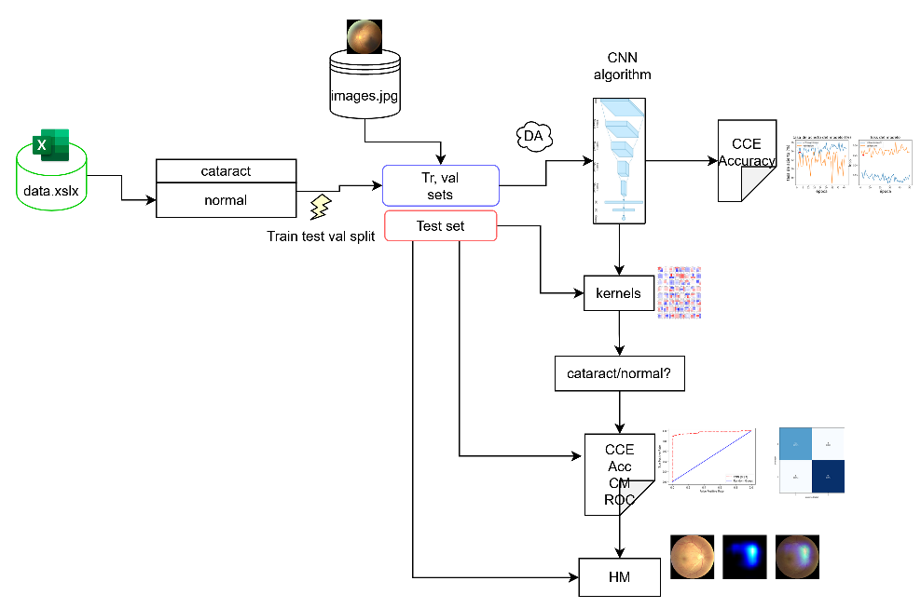
Problem overview
Supervised algorithm “specified”
Preprocessing, algorithm model and post-processing
Main steps
Data collection and filtering
Independent split
Model definition: CNN
Custom based model evolution into transfer learned model
CNN architecture “journey”
Hyper-parameters “tuning”
Metrics evaluation
Visualization

Slide 5
Section 1
Data pre processing

Slide 6
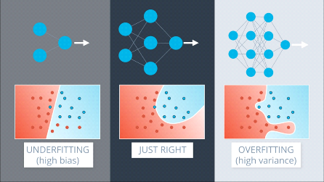
Main issues
Major consequence: overfitting
Memorizing, not learning
“To improve the mind, we must think more than memorize”
R. Descartes
1
Small Kaggle dataset: ~ 800 images: 300 cataract + 500 normal
2
One patient could have one eye with cataract and one normal

Slide 7
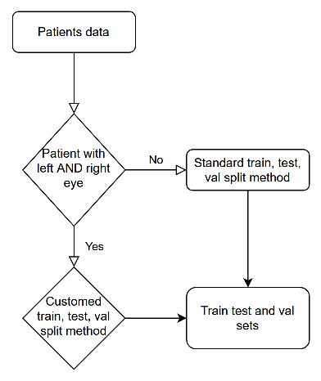
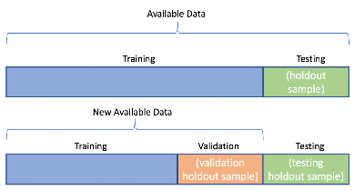
Train test split method
Not the standard way of splitting
Standard method
Custom method
Patient with left or right eye
Single eye configuration
Traditional keras method train test split
Patient with left and right eye
“Duplicated” eye configuration
Patients in test must be different than in training, otherwise test is not independent and its score is biased

Slide 8
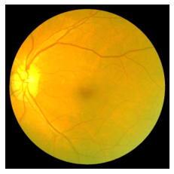
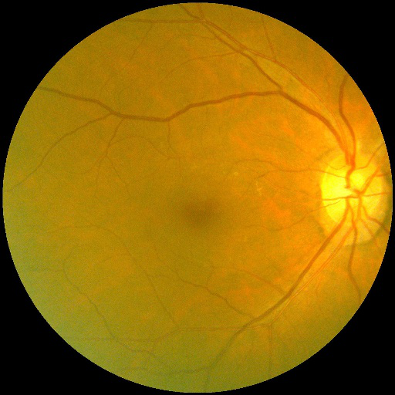
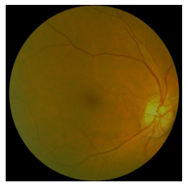
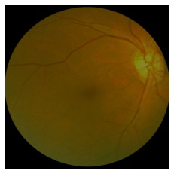
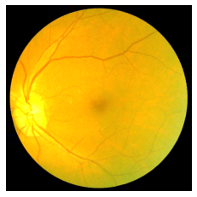
Data augmentation
One tool to defeat overfitting
Image data generator: transformations (e.g. rotation, shear, zoom) to generate «synthetic» data → learning generalization
Flow from dataframe keras method → memory-friendly approach

Slide 9
Section 2
CNN algorithm & metrics

Slide 10
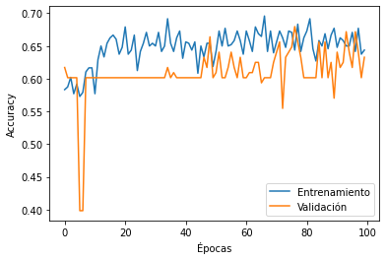
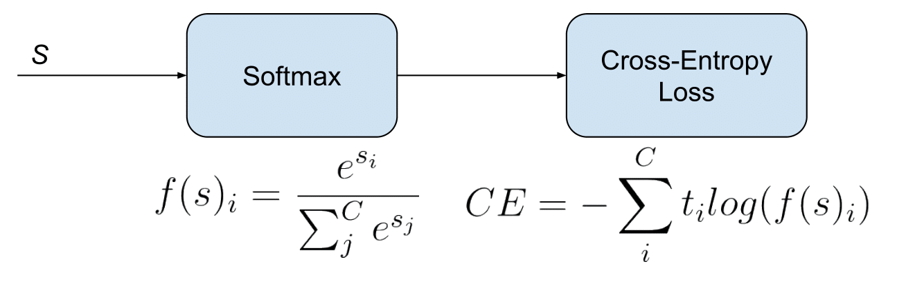
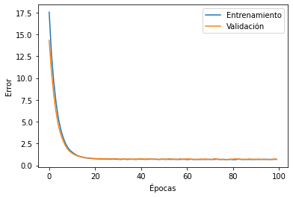
Baseline model
Custom architecture definition
Architecture overview and results
Several CONV2D layers
Batch Normalization
Regularization techniques: e.g. dropout, L1
Hyper-parameters: batch size = 32, image dimension = 224,224
Final activation function = softmax
Loss function = categorical cross entropy (label image data generator = ‘categorical’)
Optimizer: Adam
Too small dataset → deepen model → term of comparison
Even if overfitting, due to DA, controlled
Train loss = 0.74, train acc = 0.62
Test loss = 0.77, test acc = 0.64
Val loss = 0.77, val acc = 0.64

Slide 11

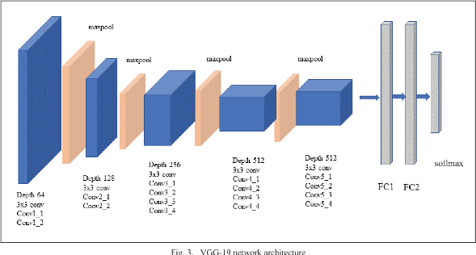
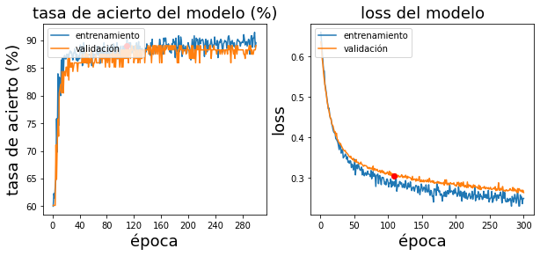
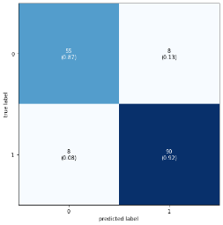

Transfer learning I
Intermediate solution
VGG19 model
With standard train test split method
Train loss = 0,25, train acc = 0.89
Val loss = 0.26, val acc = 0.89
Test loss = 0.27, test acc = 0.90
Pros:
Train loss = 0,25, train acc = 0.89
Test loss = 0.27, test acc = 0.89
Val loss = 0.76, val acc = 0.89
Cons:
Without customed train test split → biased score
Training time ~ 35 mins (GPU) → too ↑

Slide 12
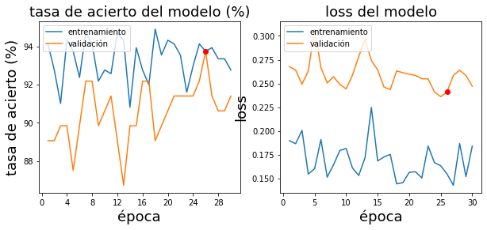
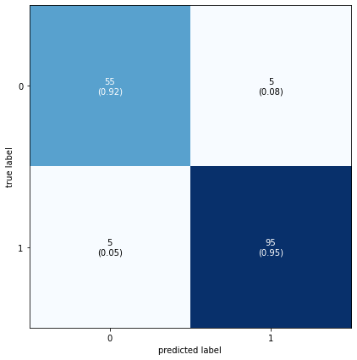
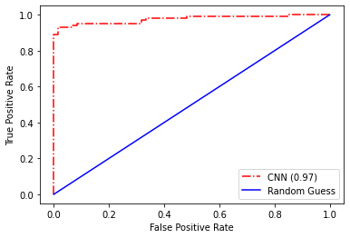
Transfer learning II
Fine tuning and custom method introduction: “definitive” model
With custom train test split method
Train loss = 0,12, train acc = 0.96
Val loss = 0.25, val acc = 0.92
Test loss = 0.19, test acc = 0.94
Small dataset utilizes power of depth → Loss ↓ , accuracy ↑, even if overfitting slightly ↑
Training time ↓ ~ 8 min (GPU)
Other regularization techniques and hyper-parameters tuning (e.g. dropout) slightly effective.
“Confusion” ↓ and equally distributed between the two classes
FP=5, FN=5
TPR=TP/TP+FN, FPR=FP/TN+FP
curve of probability
~ ideal measure of separability

Slide 13
Section 3
Visualization

Slide 14
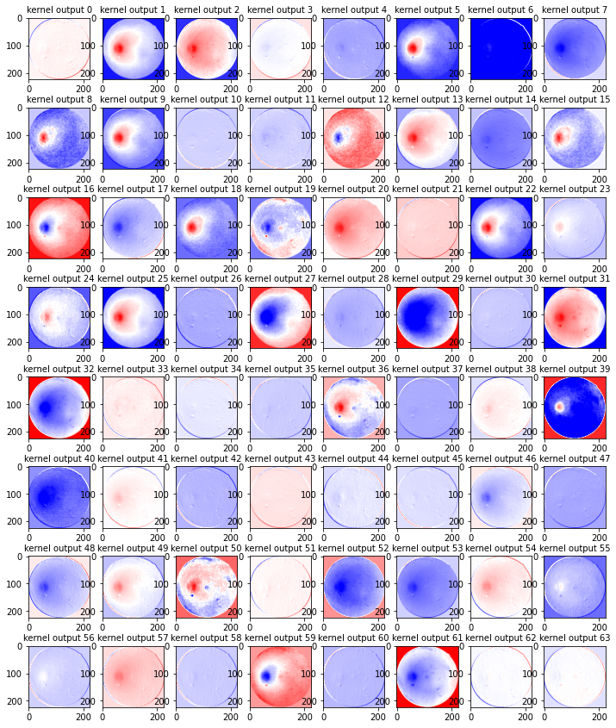
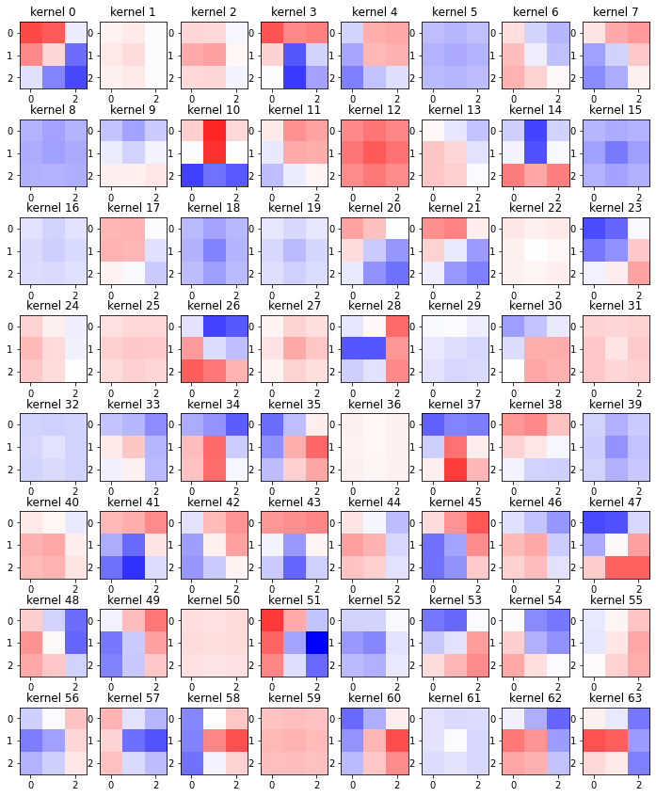
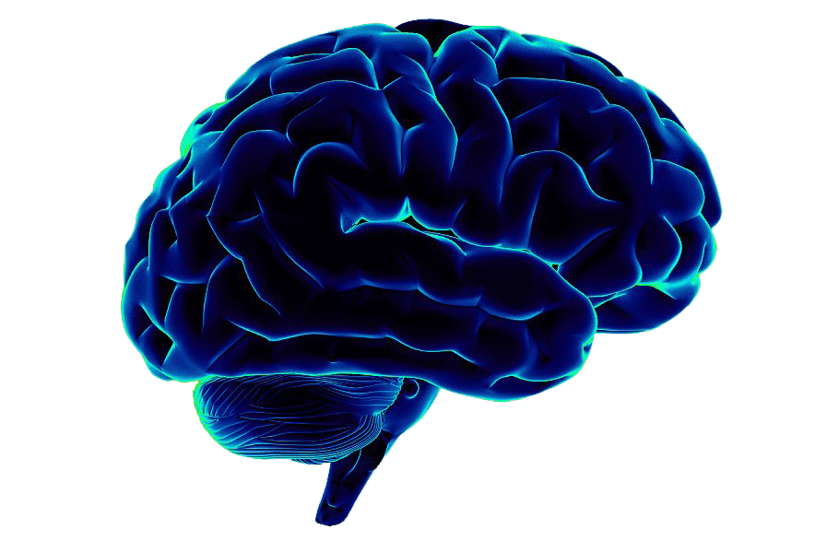
Kernels and convolved features
One layer example (normal “input” image)
Weights to be learned → features extraction
Learning parameters = weights = kernels
CNN != black boxes
Intermediate convolved output images gives the idea of what the net is focusing on → clue

Slide 15
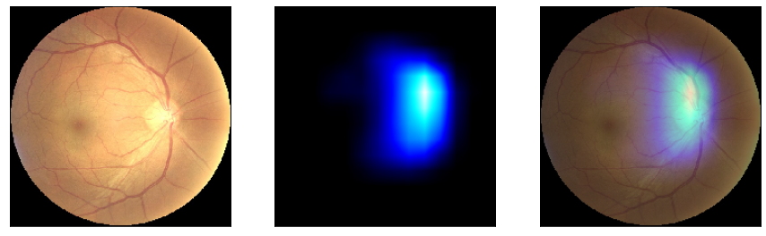
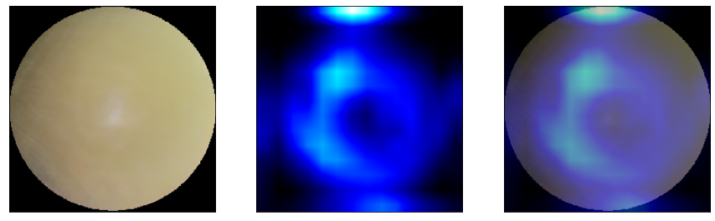
Heat Maps
Grad - CAM technique
Cataract
Example and interpretation
P(normal class) = 100%
“Perfect” optical nerve zone recognition
Normal
Example and interpretation
P(cataract class) = 99,6%
“Cloud” detection

Slide 16
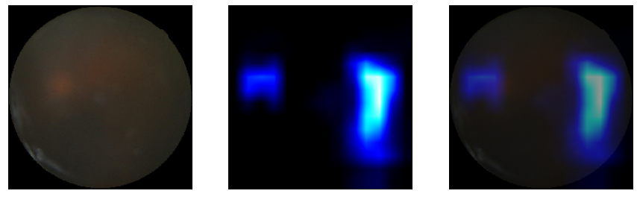
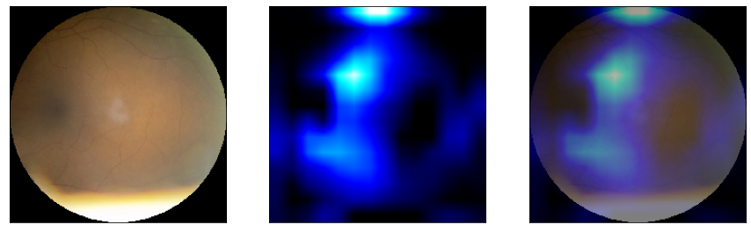
Worst mistakes
Clue to neural net “way of thinking”
Cataract predicted normal
Numbers and interpretation
P(cataract class) = 30,6%
Optical nerve misrecognition: brightness could have “mislead” kernels
Normal predicted cataract
Numbers and interpretation
P(normal class) = 6,7%
Hard to recognize optical nerve

Slide 17
Future implementations
Learning path improvement
Multi-label classification
(e.g. diabetes recognition)
Improve baseline
model
Deepen transfer learned model
5
6
7
1
2
Employ different
technique
(e.g. GAN)
8
Label more data
Code deployment
(e.g. mobile application)
More hyper-parameters
“tuning”
3
4
K-fold cross-validation

